Slide 1
Digital Electronics

Slide 2
References
A.P. Malvino and D.P. Leach, Digital Principles and Applications, Tata McGraw Hill Edition
W.H. Gothmann, Digital Electronics – An Introduction to Theory and Pratice, Prentice Hall of India Private Limited.
A. P. Malvino, J. A. Brown, Electronics : An Introduction to Microcomputers, Tata Mcgraw Hill.

Slide 3
Logic Gates

Slide 4
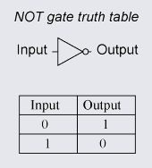
NOT Gate OR Inverter
Logic - Opposite of input

Slide 5
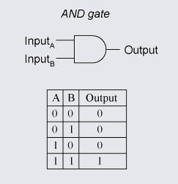
AND Gate
Logic – output is 0 if there is any input 0

Slide 6
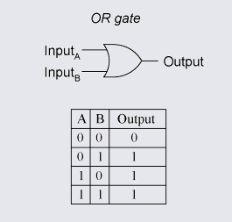
OR Gate
Logic – output is 1 if there is any input 1

Slide 7
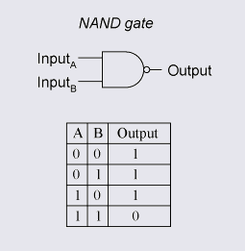
NAND Gate
Universal Gate
Logic – output is 1 if there is any input 0

Slide 8
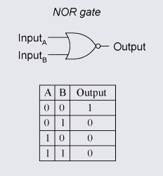
NOR Gate
Universal Gate
Logic – output is 0 if there is any input 1

Slide 9
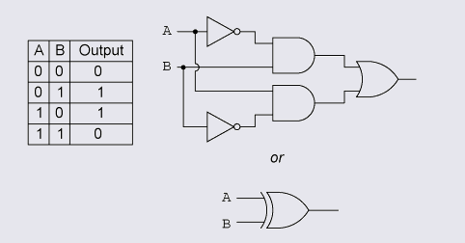
XOR Gate
Logic – output is 1 if there are odd number of 1’s in input

Slide 10
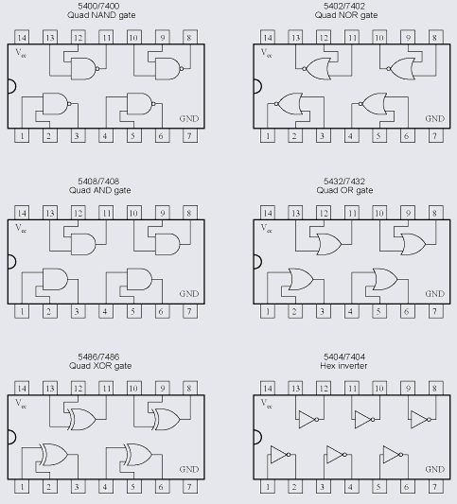
IC’s of logic gates

Slide 11
Problem
Construct NOT, OR and AND function by NAND Gate

Slide 12
Problem
Construct NOT, OR and AND function by NOR Gate

Slide 13
Problem
Propose an application based on digital circuit

Slide 14
Binary number system
Why binary number system is required in digital electronics ?
Only two states are possible
Decimal Odometer
000, 001, 002, 003…009, 010, 011..099, 100, 101
Binary Odometer
000, 001, 010, 011, 100, 101, 110, 111
Bit = X
Nibble= XXXX
Byte = XXXX XXXX
MSB LSB

Slide 15
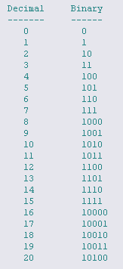

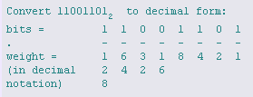
Weight of digits
Weigh of digit in decimal system
Weight of digit in binary

Slide 16
Problems
A number 7 is required to electrically transmit from one town to another town. What are possible ways ?
Convert 10101 to decimal
Convert 55 to binary
Successive division

Slide 17


Binary addition
Examples

Slide 18
Binary Adder

Slide 19
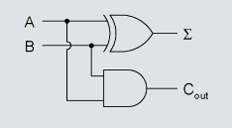
Half Adder

Slide 20
Full Adder
A
B
C
A
CARRY
B
FA
CARRY
C
SUM
SUM

Slide 21
Boolean Arithmetic
- Based on logic gate

Slide 22
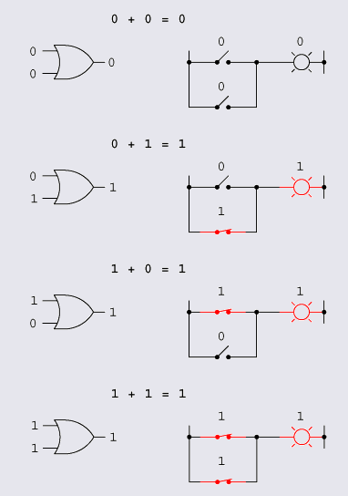
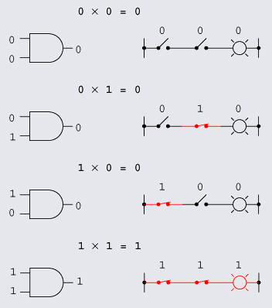
OR and AND operation
Y= A+B
Y= A.B

Slide 23
NOT, NAND and NOR
NOT
Y=
NAND
Y =
NOR
Y =
XOR
Y = ??

Slide 24
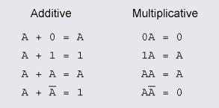
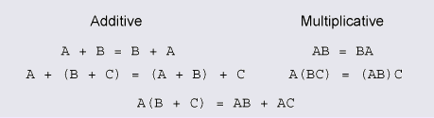
Basics of boolean algebra

Slide 25
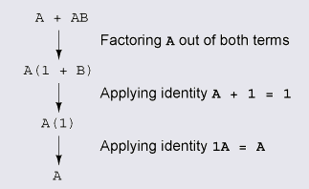
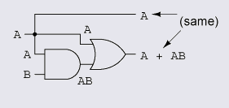
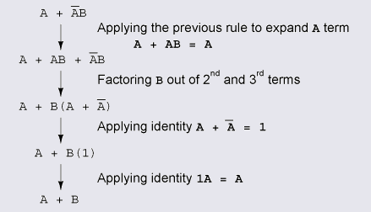
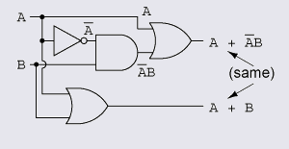
Boolean rules for simplification
A+AB=A
Truth table’s should match

Slide 26
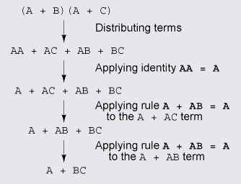
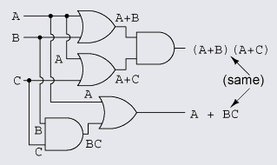
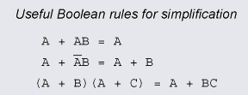
Contd.
A+BC=(A+B) (A+C)

Slide 27
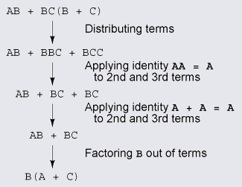
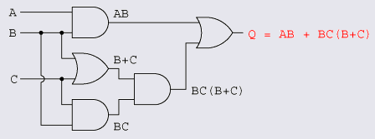
Circuit simplification example
Realize with less number of gates

Slide 28
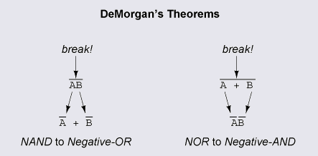
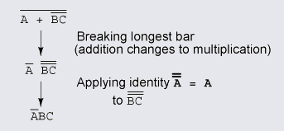
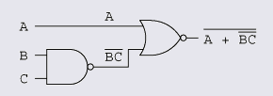
DeMorgan's Theorems

Slide 29
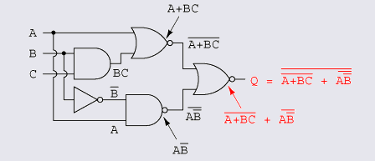
Problem
Solve
Ans

Slide 30
Problems

Slide 31
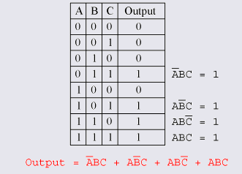
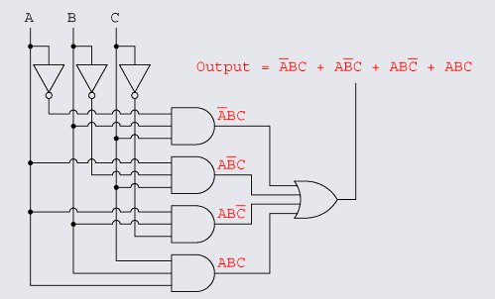
Converting truth tables into Boolean expressions
Sum of product approach
Ans AB+BC+CA

Slide 32
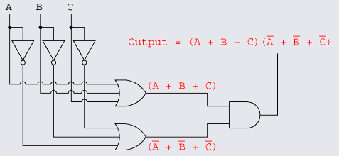

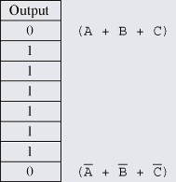
Contd.
Product-Of-Sums approach

Slide 33
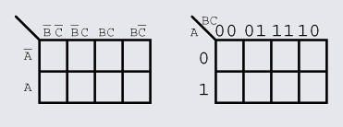
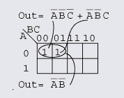
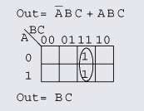
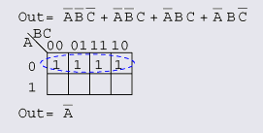
Logic simplification with Karnaugh maps

Slide 34
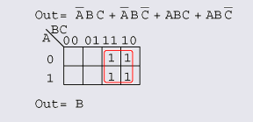
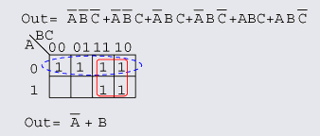
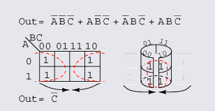
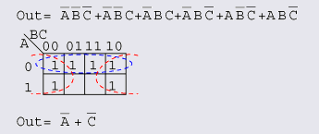
Contd.

Slide 35
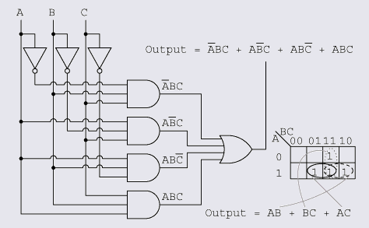
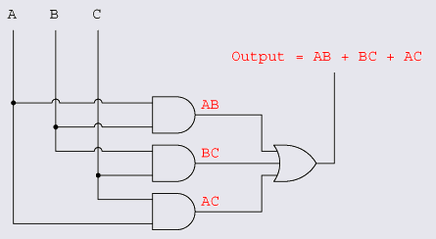
Contd.

Slide 36
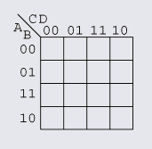
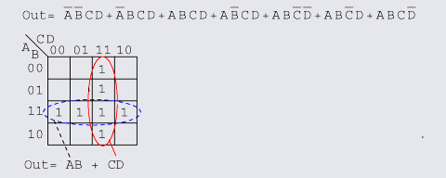
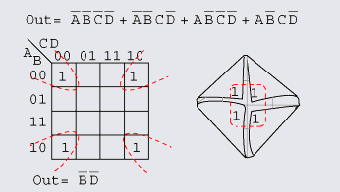
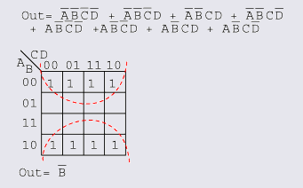
Larger 4-variable Karnaugh maps

Slide 37
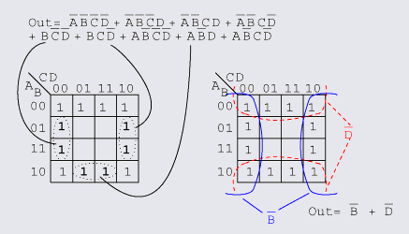
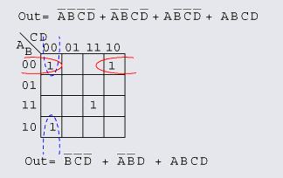
Contd.

Slide 38
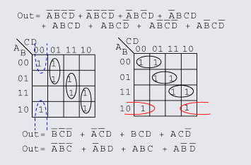
Contd.

Slide 39
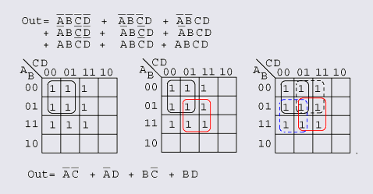
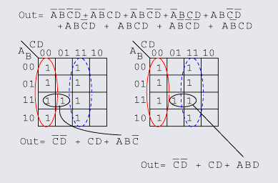

Contd.

Slide 40

Sigma Notation

Slide 41

Pi-Notation

Slide 42

Don't Care cells in the Karnaugh map

Slide 43
Problem
f= Σ m (0,1,3,4,5,7,10,13)
f= Σ m (1,2,3,5,6,7,8,12,13)
f= Σ m (0,2,6,10,11,12,13)+d(3,4,5,14,15)

Slide 44
FLIP-FLOP

Slide 45
Sequential logic
Sequential logic, unlike combinational logic is not only affected by the present inputs, but also, by the prior history

Slide 46


R-S Flip-flop or R-S latch

Slide 47

Gated S-R latch

Slide 48



D Flip-flop OR D latch

Slide 49

D Flip-Flop Response

Slide 50


Edge-triggered Response

Slide 51



Edge trigger realization

Slide 52



Edge triggered RS flip-flop

Slide 53


J-K flip-flop

Slide 54



Preset and Clear in flip-flop

Slide 55
Counters

Slide 56


Asynchronous counters

Slide 57

Contd.

Slide 58

Up and Down counter

Slide 59

Propagation delay in asynchronous counter

Slide 60

Synchronous counters

Slide 61

Contd.

Slide 62

Application of counter

Slide 63
Problem
Application of counters ?

Slide 64
Shift Register

Slide 65
Application
Shift registers produce a discrete delay of a digital signal or waveform
Very long shift registers served as digital memory

Slide 66
Shift Register Types
Serial-in/serial-out
Serial-in/parallel-out
Parallel-in/serial-out
Parallel-in/parallel-out
Ring counter

Slide 67


Serial-in, Serial-out shift register

Slide 68



Parallel-in serial out

Slide 69


Serial-in/parallel out

Slide 70
Problem
Parallel-in parallel-out circuit ?

Slide 71


Ring counter

